Slide 1


Scottish Parliament Information Centre (SPICe)
Jude Payne Traineeship in Health and Social Care Policy
Application Pack

Slide 2
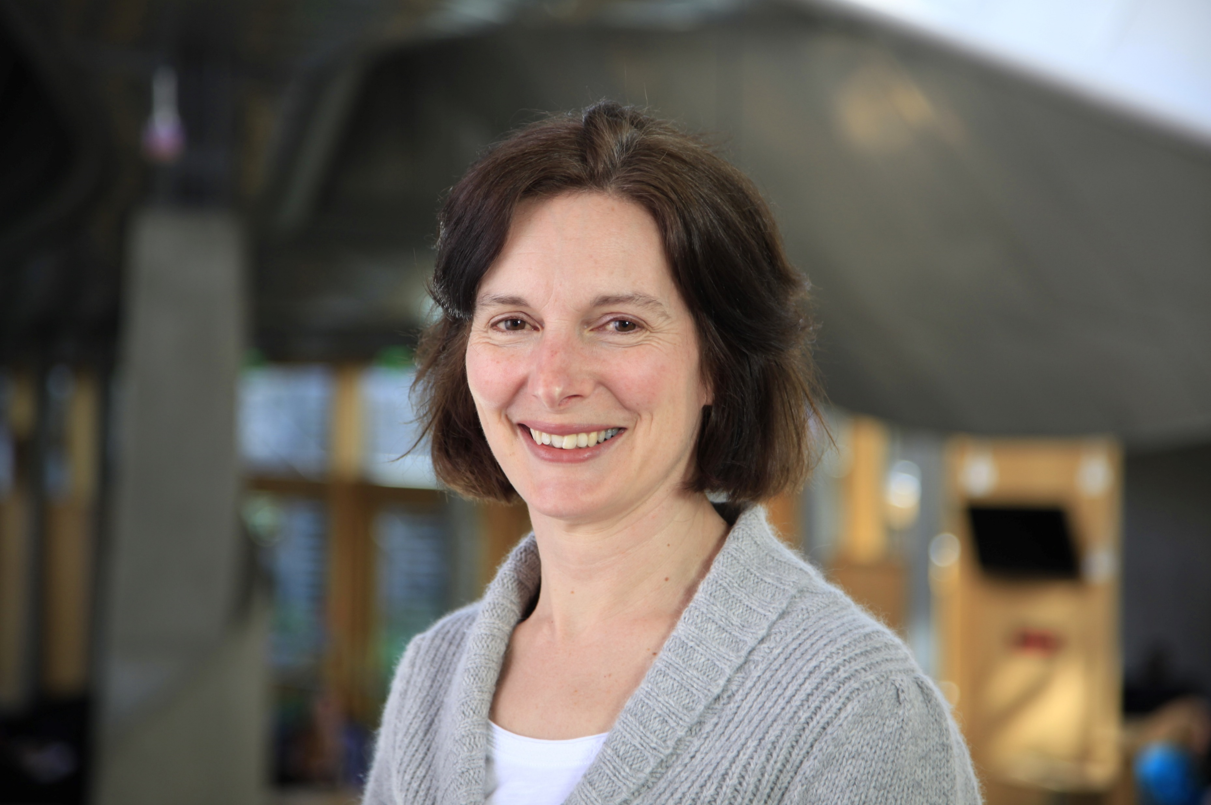

Welcome from Nicola Hudson,
Head of Research and Financial Scrutiny
Hello and welcome to the Scottish Parliament Information Centre (SPICe). SPICe, an office of about 50 staff, is responsible for providing impartial research to the Parliament.
As part of my role as one of the three joint office heads in SPICe, I manage the Health and Social Care Research Team. The team covers all aspects of health and social care, including things like COVID-19, the national care service and the impact of drugs and alcohol. As Sarah sets out on the next page, it’s a really close-knit and supportive team.
We are all really pleased that we can offer a traineeship in health policy for the fourth time, in memory of our much loved and missed colleague, Jude Payne. Our previous trainees have both gone on to exciting policy roles in Scotland and overseas. And we hope the experience we gave them here played a part in their career progression. We’ll give the trainee a broad and rich experience of policy, research and scrutiny work. But you’ll also get the chance to look deeper into a particular topic that we’ll choose with you. This means you’ll probably publish a detailed briefing and some blog articles as well.
If you’re interested in developing your career in health policy and playing a role in supporting scrutiny of health and social care policy in Scotland, we’d love for you to apply, or please feel free to get in touch with me for a chat.

Slide 3
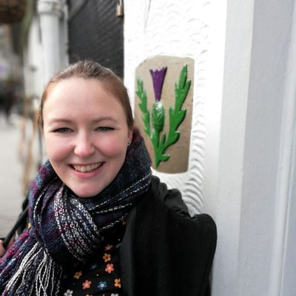

Working in the Scottish Parliament Information Centre (SPICe)
Sarah Swift, Researcher in the Health and Social Care Research Team, explains what it's like to work here
I joined SPICe as a Grade 4 Researcher in August 2022. Before coming to the Scottish Parliament, I was an academic researcher specialising in dementia. I loved working in research, but I wanted a role with more stability and variety. Being part of the health and social care research team in SPICe has given me the chance to use my research skills in a new environment and explore a diverse range of new topics.
Since joining SPICe, I’ve had lots of opportunities for development, and to learn more about how the Parliament works. I’ve also made connections with health and social care researchers in other UK Parliaments, joined SPICe’s Academic Engagement team, and helped with planning networking events at the Parliament.
When I first joined SPICe, everyone was very welcoming and it’s a very friendly team. The Parliament’s flexible working arrangements offer a great work-life balance, which is very helpful as the parent of a young child. I’m looking forward to seeing where my role takes me in the future, and to becoming more involved in the many opportunities available at the Parliament.

Slide 4

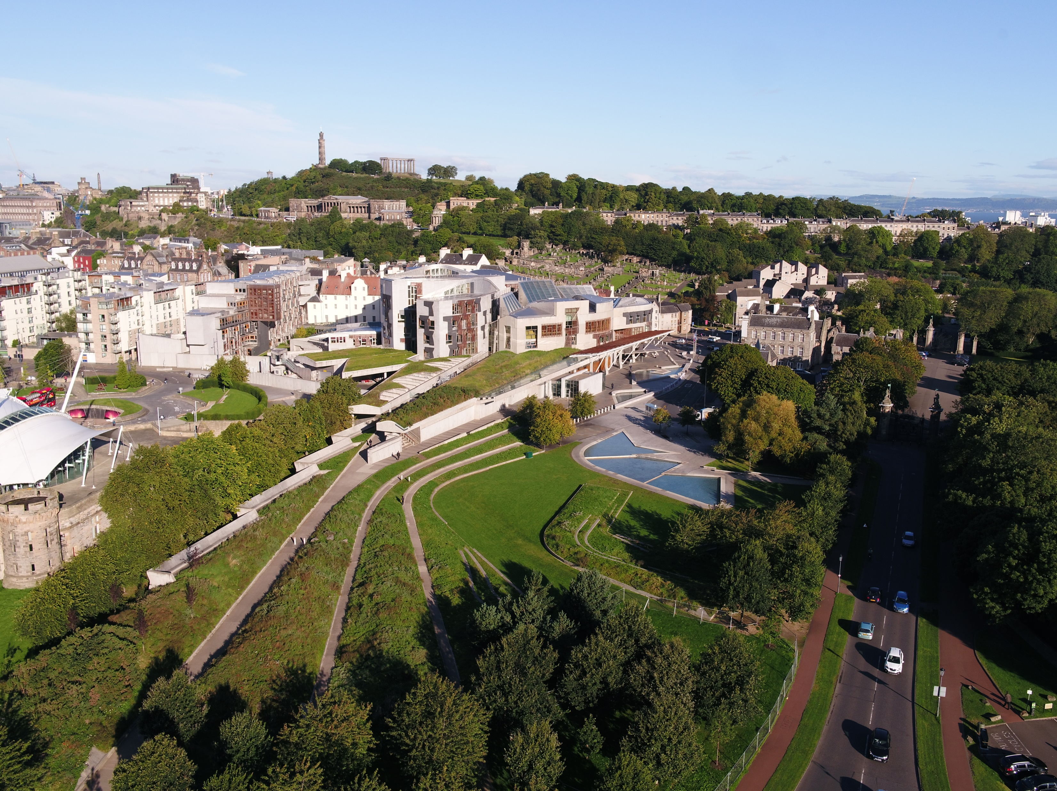

Jude Payne Traineeship in Health and Social Care Policy– Scottish Parliament Information Centre (SPICe), Grade 2
Salary: £30,360, pro-rated for six months
Working pattern: This is a full-time position for 6 months, although applications from those seeking alternative working patterns are welcomed. This post may also be suitable for a secondment (subject to the donor organisation’s agreement).
A unique springboard for your career in health policy.
Want to make a difference in one of the most influential places in Scotland? Now is your chance!
About the Scottish Parliament Information Centre
The Scottish Parliamentary Corporate Body is responsible for providing the Parliament with the property, staff and services required for the Parliament’s purposes. We place high value on excellence and we are continually looking to improve how we work to ensure that we can deliver the Parliament's core purpose of representing the people of Scotland by debating issues of national importance, passing legislation and holding the Scottish Government to account.
The Scottish Parliament Information Centre (SPICe) provides impartial information and analysis to individual MSPs of all parties and their staff (both in Holyrood and in the constituency offices), and to the parliamentary committees.
SPICe has a team of around 50 staff, including 30 subject specialist researchers. Currently almost £20 billion is spent on health each year and four SPICe researchers brief the committees and individual MSPs on a wide range of topics in this area.
You can look at the type of briefings produced by SPICe and read our blogs on SPICe Spotlight.
This is a full time post but we are happy to talk Flexible Working

Slide 5
Jude Payne Traineeship in Health and Social Care Policy– Scottish Parliament Information Centre (SPICe), Grade 2
In memory of Scottish Parliament Information Centre (SPICe) health and social care researcher Jude Payne we are delighted to offer a unique six-month traineeship in health and social care policy and research.
About the role
The successful candidate will be employed by the Scottish Parliament (based in SPICe) for 6 months. This is likely to be January-June 2025, but there is some flexibility in timings depending on availability.
The trainee can expect a broad and rich experience of policy, research and scrutiny work, but will also have a remit to look deeper into a particular topic, agreed with both SPICe and the trainee. We expect the trainee would produce or contribute to at least one published output such as a SPICe briefing or a series of blog articles.
About you
You’ll be an enthusiastic recent graduate, undergraduate or early career health or social care professional keen to learn about one of Scotland’s key policy areas, and how research and analysis is carried out by the Scottish Parliament when holding the Scottish Government to account.
You’ll have a good understanding of major health and/ or social care policy issues and the ability to explain complex topics in a clear and understandable matter, as well as an enthusiastic attitude to tackling new challenges.
For full information about the role, please see the job description below.
If you have any questions about the role or the application process, please contact Nicola Hudson, Head of Research and Financial Scrutiny in SPICe, by email to nicola.hudson@parliament.scot
This is a full time post but we are happy to talk Flexible Working

Slide 6
Jude Payne Traineeship in Health and Social Care Policy– Scottish Parliament Information Centre (SPICe), Grade 2
How to apply
Applying for this traineeship is straightforward.
Please send us a short CV – just two sides of A4 maximum, covering your relevant education, career history, responsibilities and achievements
Please send us a short written briefing on health policy (details below)
Email both to careers@parliament.scot by 11.59pm on Friday 15 November.
For details on how we will process your personal data please refer to our Recruitment Privacy Notice.
A briefing on health policy
Please think about the following question:
What factors have influenced productivity in the health sector over the last five years and what potential policy actions could address the issue?
The intended audience for this briefing are non-specialists with a keen interest in the topic. You should demonstrate:
An understanding of some of the major policy issues for health.
An ability to explain complex issues in a clear and understandable manner.
The ability to operate in a political environment and to contribute to impartial and impactful research.
We are looking for something short and straightforward, so please provide us with a written briefing of no more than 800 words.
This is a full time post but we are happy to talk Flexible Working

Slide 7
Delivering for Excellence - Jude Payne Traineeship in Health and Social Care Policy, Grade 2
The Scottish Parliament is a values-led organisation which means our values of stewardship, excellence, inclusiveness and respect, are at the centre of everything we do. These values are embedded in this role. Please visit our values pages in our Employee Handbook.
Stewardship
Focusing on the longer term to ensure we are leaving things better than we found them and putting our shared interests ahead of any individual or team.
Your main responsibilities will involve:
Contributing to the research and information services that SPICe provides to Members, parliamentary committees and to the staff of the Parliament.
Working to help the Parliament achieve its corporate objectives, including improving the quality and effectiveness of scrutiny.
And in delivering these you will have:
An interest in current affairs and an awareness of the role of the Scottish Parliament.
The ability to operate in a political environment and to contribute to impartial and impactful research to MSPs, Committees and parliamentary officials

Slide 8
Delivering for Excellence - Jude Payne Traineeship in Health and Social Care Policy, Grade 2 (Cont.)
Excellence
Taking care to enhance our reputation in everything we do. Using our skills and resources efficiently and effectively to deliver high-quality sustainable results.
Your main responsibilities will involve:
Development of your knowledge of health policy and the role of the Scottish Parliament in policy development and scrutiny
Production of at least one published briefing or series of blog articles on health policy
Other tasks including answering MSP enquiries, and briefing on petitions
And in delivering these you will have:
An understanding of some of the major policy issues for health
An ability to understand and analyse complex policy issues drawing on a wide range of sources
Good quantitative and numerical reasoning skills
An ability to explain complex issues in a clear and understandable manner – both in written form and face to face

Slide 9
Delivering for Excellence - Jude Payne Traineeship in Health and Social Care Policy, Grade 2 (Cont.)
Respect
Appreciating difference, building cohesive teams and fostering the values and experiences of diversity.
Your main responsibilities will involve:
Establishing effective relationships to enable you to work closely with colleagues to deliver high quality services
Working within the values of the Parliamentary Service and contributing to an inclusive working environment
And in delivering these you will have:
The ability to form effective working relationships with team members
A flexible approach to support team members, and a willingness to be pro-active and take the initiative

Slide 10
Delivering for Excellence - Jude Payne Traineeship in Health and Social Care Policy, Grade 2 (Cont.)
Inclusiveness
Understanding the big picture and seeking out alternative perspectives. Every colleague feels they can make a valued contribution and deliver their best work.
Understanding the big picture and seeking out alternative perspectives. Every colleague feels they can make a valued contribution and deliver their best work.
Your main responsibilities will involve:
Supporting the work of the Senior Researchers in representing the Parliament at external events and networks to increase the visibility and profile of SPICe and our work.
Involvement in a wide range of other tasks as designated by Senior Researchers to give a broad range of experience and to help deliver services.
And in delivering these you will have:
An enthusiastic attitude to tackling new challenges and taking an innovative approach to achieve results
A record of working collaboratively with others, and a willingness to share knowledge and information to improve SPICe services.

Slide 11
About us
Our vision is clear: To make a positive difference to the lives of the people of Scotland. This means putting people at the centre of everything we do.
We attach great importance to our commitments to Diversity and Inclusion and our core values of stewardship, excellence, respect and inclusiveness form a central part of our working culture.
Our performance framework helps us to communicate and implement our strategic priorities through the parliamentary service. The strategic plan sets out our aims and priorities. This provides a set of shared priorities for everyone across the parliamentary service and covers matters such as improving parliamentary scrutiny, developing and investing in our staff, aligning public engagement with parliamentary business and providing high quality support to our elected Members. Each of the aims is equally important as they are inter-related. This means that we cannot achieve one without the others and that every one of our colleagues plays an important role in delivering them.
The Parliamentary Service of over 600 people is a high-achieving and professional organisation. We are public servants rather than civil servants; we serve the Parliament and its Members and not the Scottish Government.
The Scottish Parliamentary Corporate Body is responsible for providing the Parliament with the property, staff and services required for the Parliament’s purposes, in accordance with the Scotland Act 1998. It is made up of five Members elected by the Parliament and the Presiding Officer.
The Corporate Body delegates the day-to-day running of the Parliament to David McGill, our Clerk/Chief Executive.
David is assisted by his Senior Executive Team in setting the strategic direction for the parliamentary service and for creating the conditions that helps to promote a positive workplace culture. You can view our structure and offices in our organisation chart.

Slide 12



About us (Cont.)
We are committed to providing a great working environment where people enjoy coming to work and feel valued for their contribution and excel in their chosen careers. Everyone has the right to be treated with respect and dignity and we have a zero tolerance approach to bullying, harassment or victimisation of any kind. We recognise that improving employee engagement has a positive and significant effect on organisational performance. We know that ideas generated by colleagues can help shape the future direction of our services and contribute to the successful
delivery of our goals, and our inclusive leadership style guides us in this approach.
We are committed to building a workforce which reflects the diversity of the people of Scotland. We are proud to be an equal opportunities employer that values and respects the people who work for us. We seek to ensure all job applications are treated
fairly, with respect and without bias. We positively encourage applications from suitably experienced candidates regardless of sex, race, disability, age, sexual orientation, gender reassignment, religion or belief, marital status, or pregnancy and maternity. We particularly welcome applications from female and minority ethnic candidates who are under-represented at this level. All appointments will be made on merit.
We are committed to agile working and currently operate a wide variety of work patterns and arrangements across the parliamentary service. We will be pleased to consider
applications from candidates wishing to work flexibly and all requests will be seriously considered. Please include clearly any information about your preferred working arrangements in your application.

