Slide 1
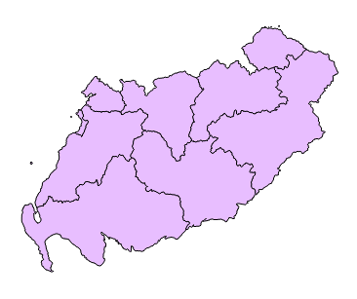
Kilmarnock & Irvine Valley
East Lothian
Midlothian South, Tweeddale & Lauderdale
Clydesdale
Ayr
Ettrick, Roxburgh & Berwickshire
Carrick, Cumnock & Doon Valley
Dumfriesshire
Galloway & West Dumfries

Slide 2
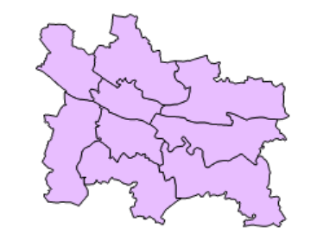
Glasgow Maryhill & Springburn
Glasgow Anniesland
Glasgow Kelvin
Glasgow Provan
Glasgow Pollok
Glasgow Southside
Glasgow Shettleston
Glasgow Cathcart
Rutherglen

Slide 3
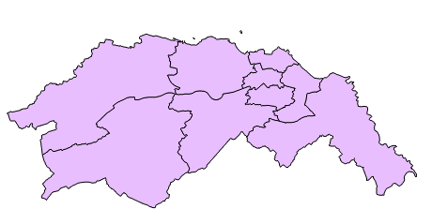
Edinburgh
Northern & Leith
Edinburgh
Central
Edinburgh
Eastern
Edinburgh
Western
Linlithgow
Midlothian North & Musselburgh
EdinburghPentlands
Almond Valley
Edinburgh
Southern

Slide 4
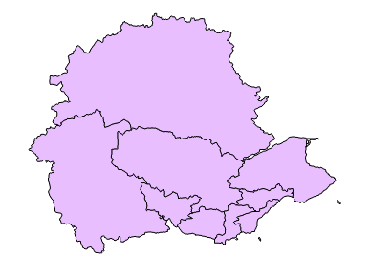
Perthshire North
Perthshire South and Kinross-shire
North East Fife
Stirling
Mid Fife & Glenrothes
Kirkcaldy
Clackmannanshire & Dunblane
Dunfermline
Cowdenbeath

